Slide 1


Movie Investor Guide
Team Fuzzywuzzy:
Nandu
Nisha
Eyamba
Anupa
RJ

Slide 2
Project Scope
Project Description
Build reports to support high level analysis for investing in a new movie production
Scope of Research:
Movie trends
Director’s performance

Slide 3
Questions & data
Research questions:
What are the top 5 movie genres by popularity and ROI
Top directors by genres based on popularity and ROI
Data requirements and data source
Need movie data with budget, revenue and rating information
Found required movie data on Kaggle.com

Slide 4
Data prep & cleanup
Movie genre is a list of dictionaries [{}] – really?
No it is a string
Where is the Director
Movie title – what language is that?
Show me the Money

Slide 5
Did you know?
Want to know some fun facts?
Top movie by ROI ever
Top box office collection movie ever
Best director by popularity
Movie | ROI | Budget | Revenue | Popularity score | Director
Paranormal Activity | 1,288,939% | 15,000 | 193,355,800$ | 12.7 | Oren Peli
Avatar | 1,076% | 237,000,000 | 2,787,965,087$ | 1076 | James Cameron
Minions | 1,463% | 74,000,000 | 1,156,730,962$ | 547.5 | Kyle Balda

Slide 6
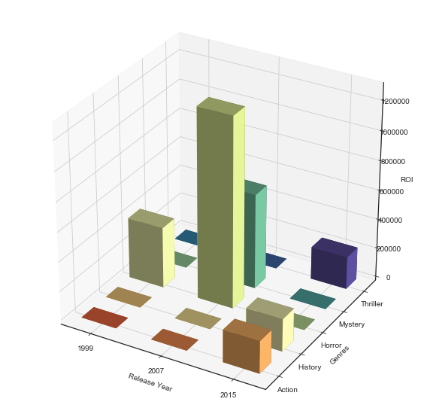

Data viz

Slide 7
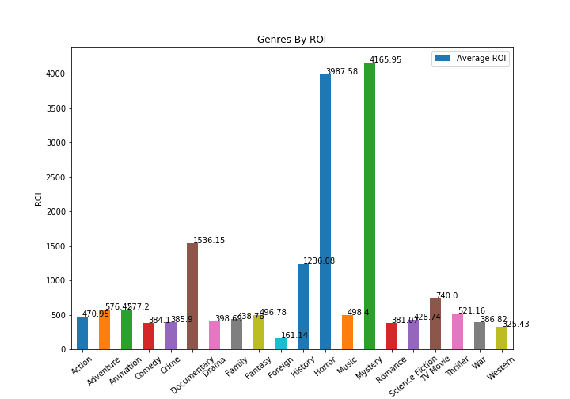
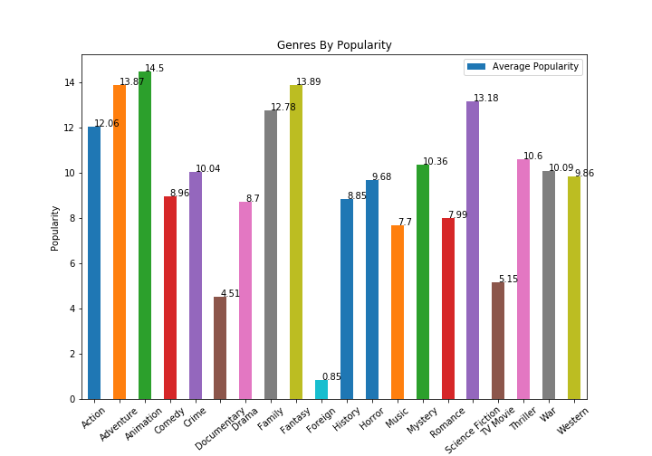
Data viz continued…

Slide 8
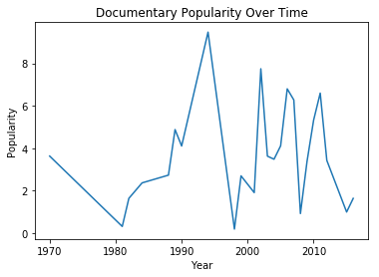
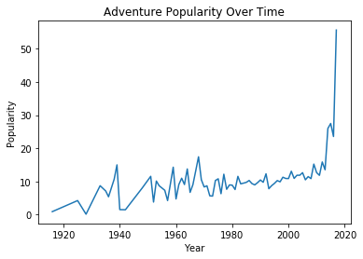
Data viz continued…

Slide 9
Data Analysis
Discuss the steps you took to analyze the data and answer each question you asked in your proposal
Discussion
Discuss your findings. Did you find what you expected to find? If not, why not? What inferences or general conclusions can you draw from your analysis?
Post Mortem
Discuss any difficulties that arose, and how you dealt with them
Discuss any additional questions that came up, but which you didn't have time to answer: What would you research next, if you had two more weeks?

Slide 10
Q&A

